Slide 1
超越学科界限的认知基础 Transdisciplinary Cognitive Foundation Namespace Management Week 2
Ben Koo
September 21, 2020

Slide 2
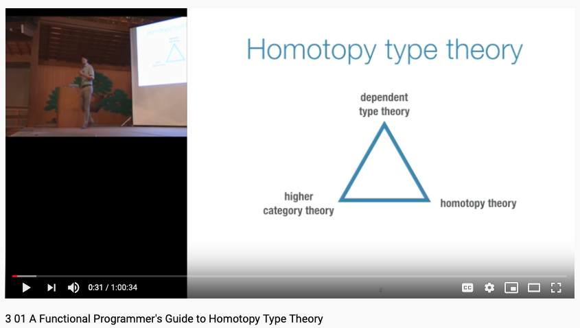
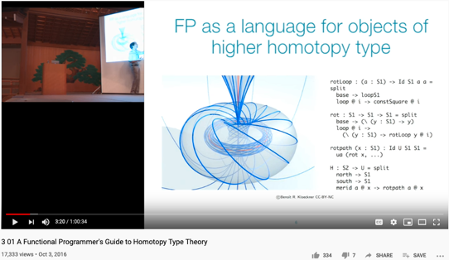
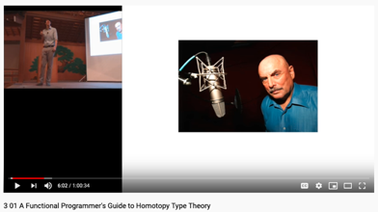
This is not just a SOUND TEST, it is also a story about Data in a world where …
Don Lafontaine
A transdisciplinary foundation in math and programming by Prof. Dan Licata, Wesleyan University

Slide 3
Content Themes for the semester
Overview (Today)
Namespace Management
Biology, Physics, Math, Code is Law, and Society
Story Telling, Functions/Metaphors/Analogies
Writing, Accounting, Historical Data and Temporal Reasoning
Knowledge Representation in Wiki and Files
Recursion and Continuation (DevOps/CICD)
Midterm Report
Cybernetics (Control and Communication)
Smart City and Internet of Things
Artificial Intelligence and its Social Impacts
Arts/Skills/Human Talents in the Digital Era
Student proposed Application Topics
Rehearsal
Final Reports and Celebration

Slide 4
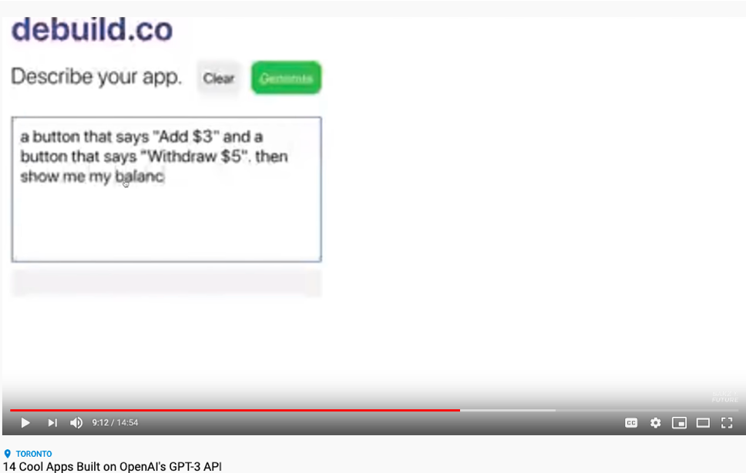
Demo of Open AI’s GPT-3
Huawei VP Mr. Yang Shaoqing
RICH 70 Tsinghua SEA Cloud Forum, Sep 14, 2020
H. E. Bambang Brodjonegoro,
Minister of Research & Technology, Indonesia

Slide 5
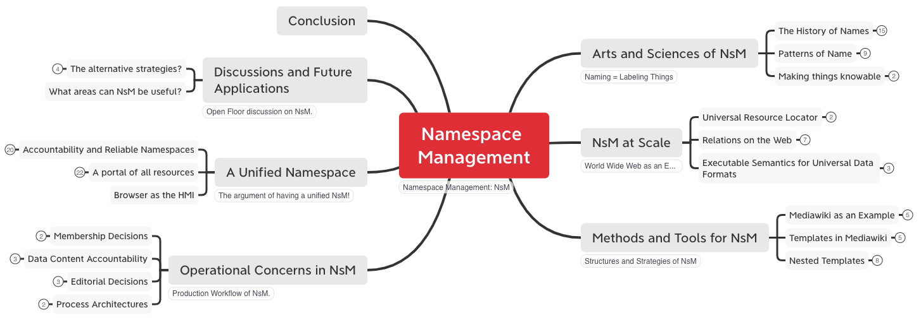
Lecture Outline

Slide 6

Arts and Sciences of NsM
History of Names
Patterns of Names
Trust-worthy Names
Namespace management is the Cognitive Foundation.

Slide 7
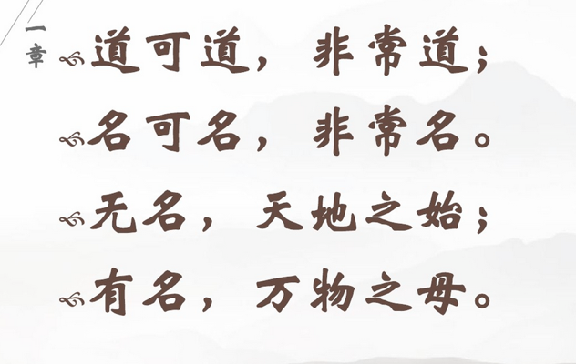

Names gave birth to Cognitive Abilities - Laozi
Huawei VP Mr. Yang Shaoqing
RICH 70 Tsinghua SEA Cloud Forum, Sep 14, 2020
H. E. Bambang Brodjonegoro,
Minister of Research & Technology, Indonesia

Slide 8
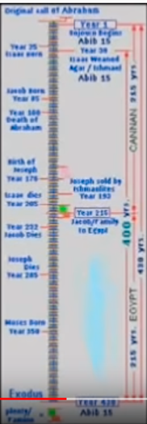
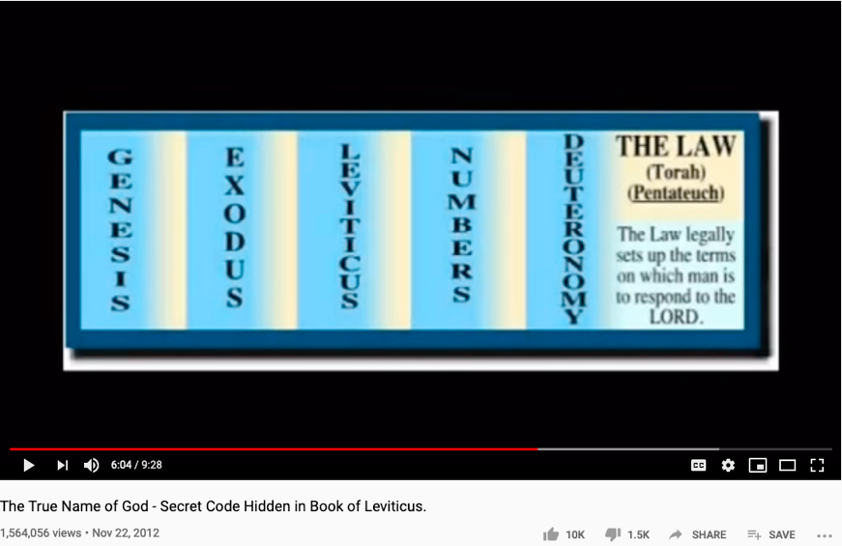
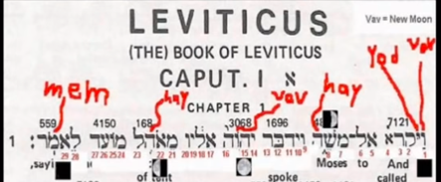
The History of True Names
Huawei VP Mr. Yang Shaoqing
RICH 70 Tsinghua SEA Cloud Forum, Sep 14, 2020
H. E. Bambang Brodjonegoro,
Minister of Research & Technology, Indonesia
How Gods are forgotten:
https://youtu.be/xgyMY9w7-ew?t=278

Slide 9
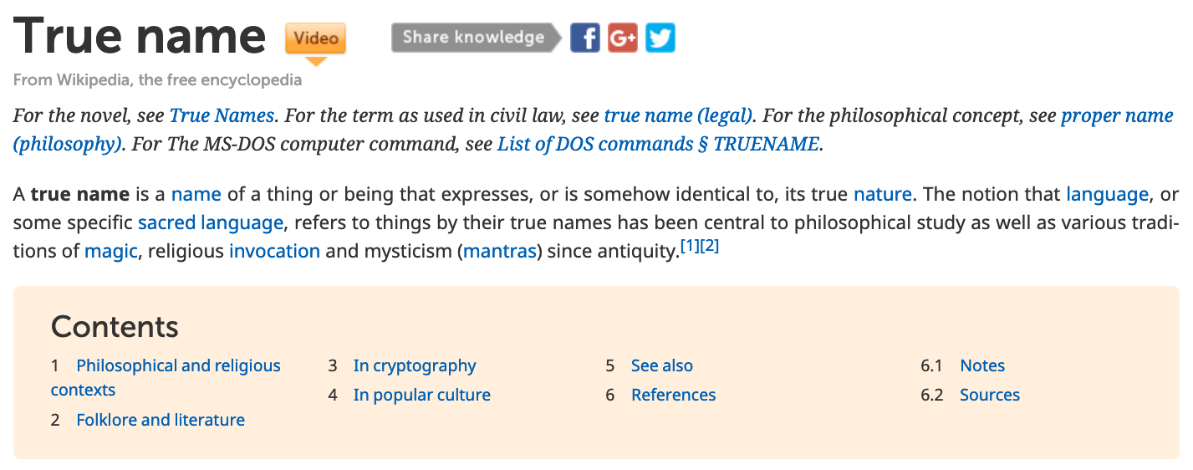
True Name defined by Wikipedia

Slide 10




Labels, Linguistics, and Cognitive Science
Image Source: https://georgelakoff.com/

Slide 11
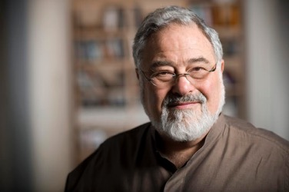
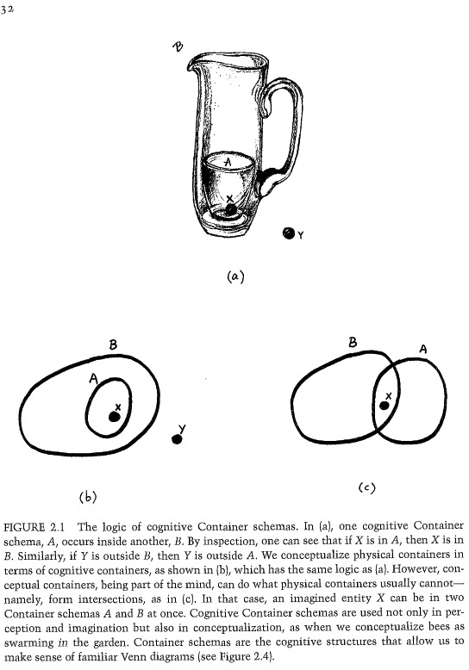
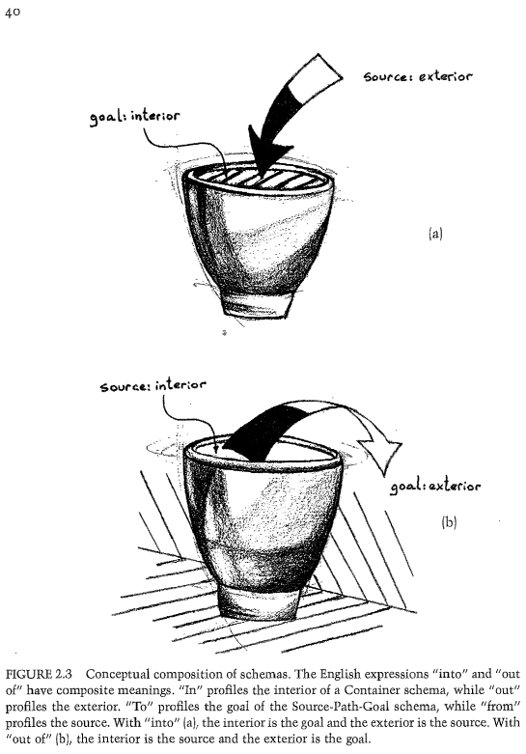
The expressive power of Names (labels)
Huawei VP Mr. Yang Shaoqing
Prof. George Lakoff

Slide 12
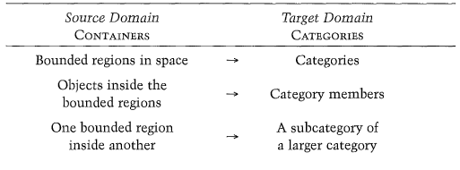
Categories are Containers of cognitive concepts
Huawei VP Mr. Yang Shaoqing

Slide 13
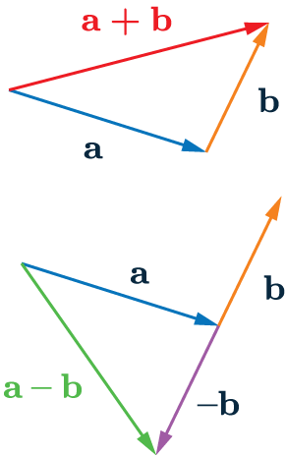
Patterns of Categories/Classification of Concepts
Grounded Ideas:
Adding (+): including objects into a collection
Subtraction (-): taking objects away from the collection
Sets: containers of elements
Abstract Ideas:
Numbers as points on a line
Geometrical figures as algebraic equations

Slide 14
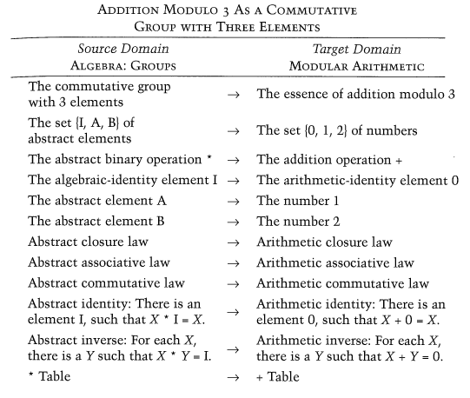
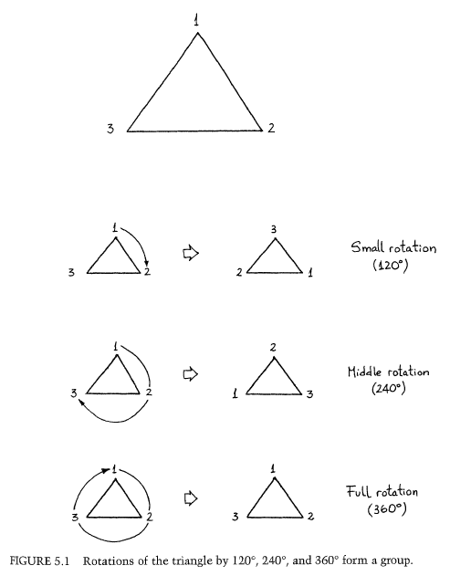
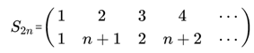
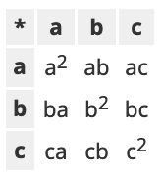
Combine Operands/Operations as constructed names?
Cayley Table

Slide 15
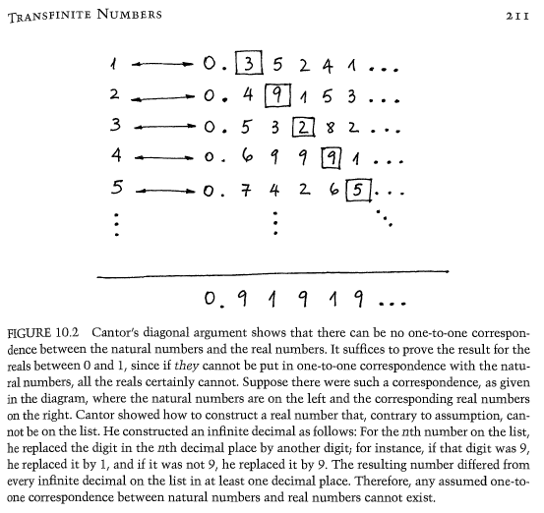
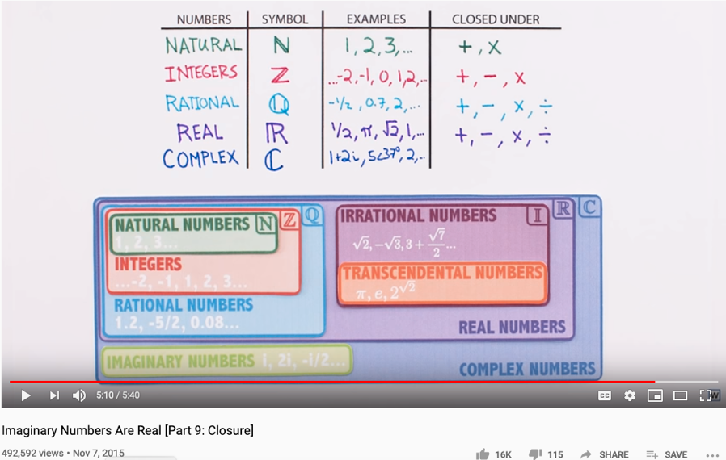
The Complete set of Generative Names
Huawei VP Mr. Yang Shaoqing
RICH 70 Tsinghua SEA Cloud Forum, Sep 14, 2020
H. E. Bambang Brodjonegoro,
Minister of Research & Technology, Indonesia

Slide 16

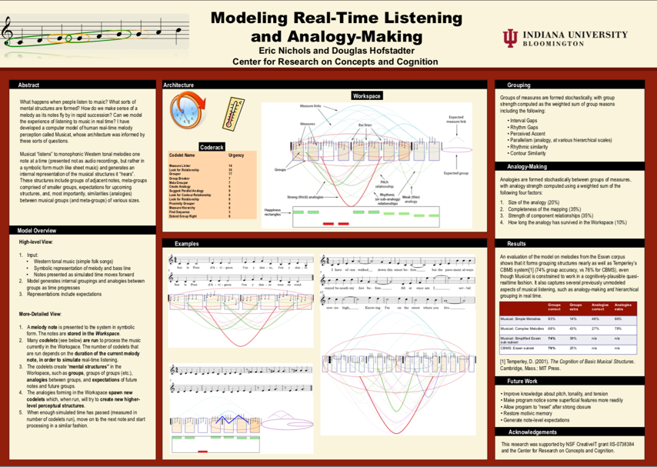
Names as Generalized Metaphors
Huawei VP Mr. Yang Shaoqing
RICH 70 Tsinghua SEA Cloud Forum, Sep 14, 2020
H. E. Bambang Brodjonegoro,
Minister of Research & Technology, Indonesia

Slide 17


The properties of being Trust-worthy name schemes
Soundness:
All names refer to at least one legal entity
Completeness:
All legal entities must all have at least one name
Controlled Access Rights
Non-repudiation:
Every name only points to one unique legal entity
Tamper-Proof:
Authorized entities can make changes
Any change to the name system must become public knowledge
Time-based:
All name changes should be time-stamped by one coherent clock
Huawei VP Mr. Yang Shaoqing
RICH 70 Tsinghua SEA Cloud Forum, Sep 14, 2020
H. E. Bambang Brodjonegoro,
Minister of Research & Technology, Indonesia

Slide 18


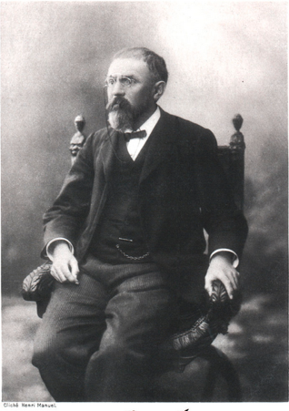
“Mathematics is the art of giving the same name to different things!” - Henry Poincare

Slide 19
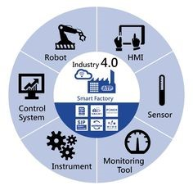
NsM at Scale!
Relations on the Web
URL: Universal Resource Locator
Universal Data Formats
Physical Objects connected through Namespaces

Slide 20

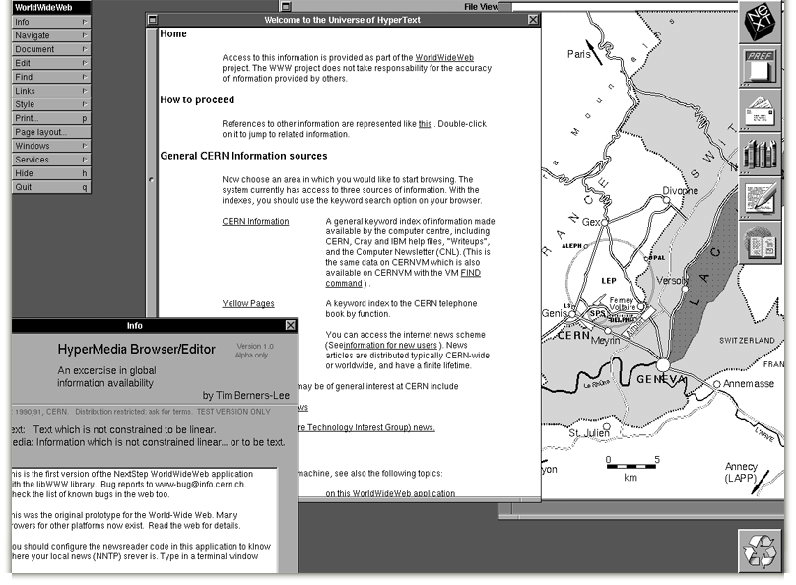
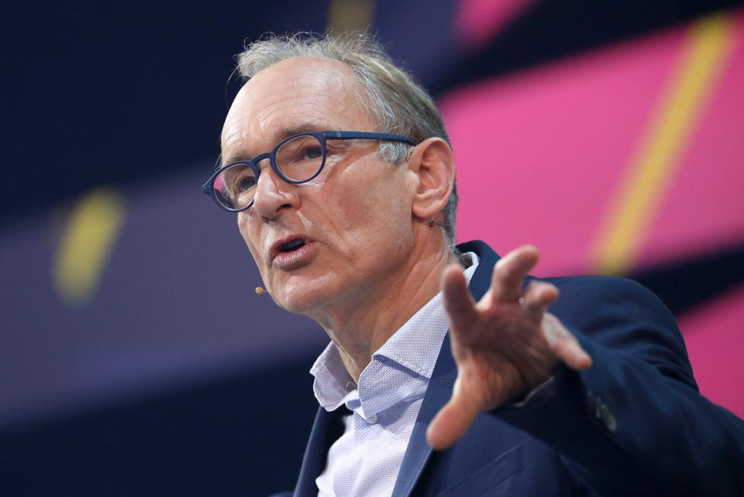


Namespace Management on the Global Scale
Berners-Lee called his vision for the web “utopian.”
He wanted it to be a place where all people had access to the best information at any time.

Slide 21
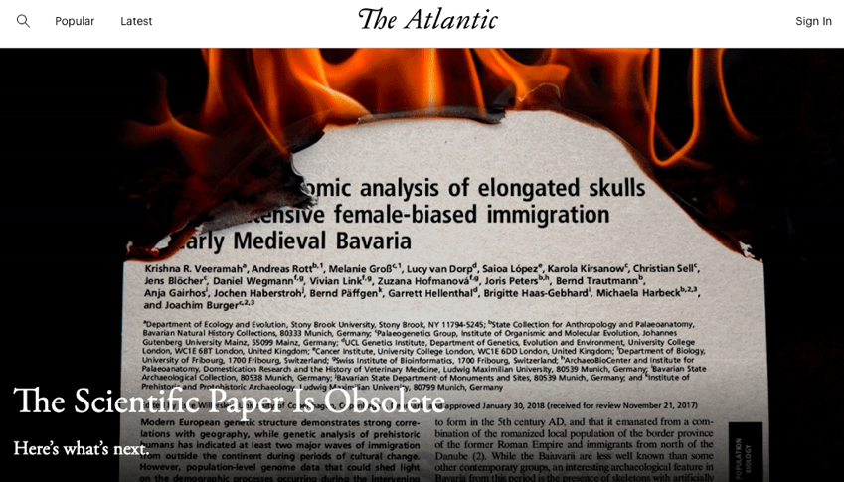
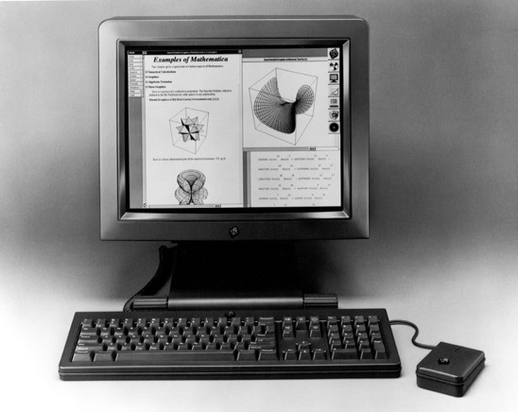
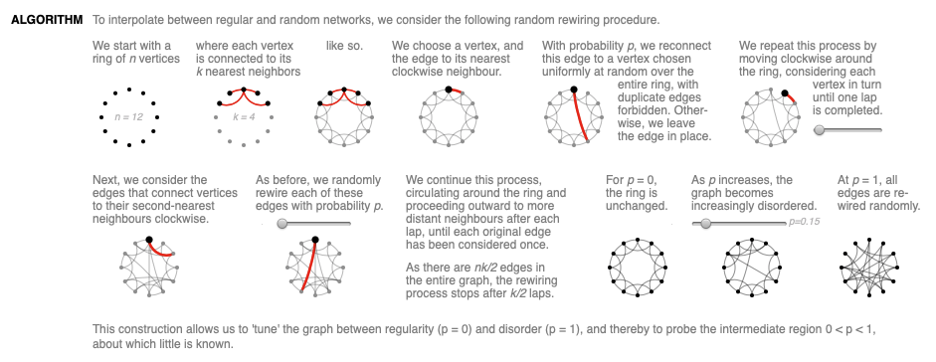

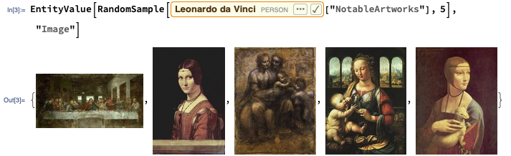
The origin and the Future of the “Web”
Theodore Gray created an Editable Interface for Computable Documents.
The technology is based on Mathematica, and was bundled with NeXT computers used by Berners-Lee.

Slide 22
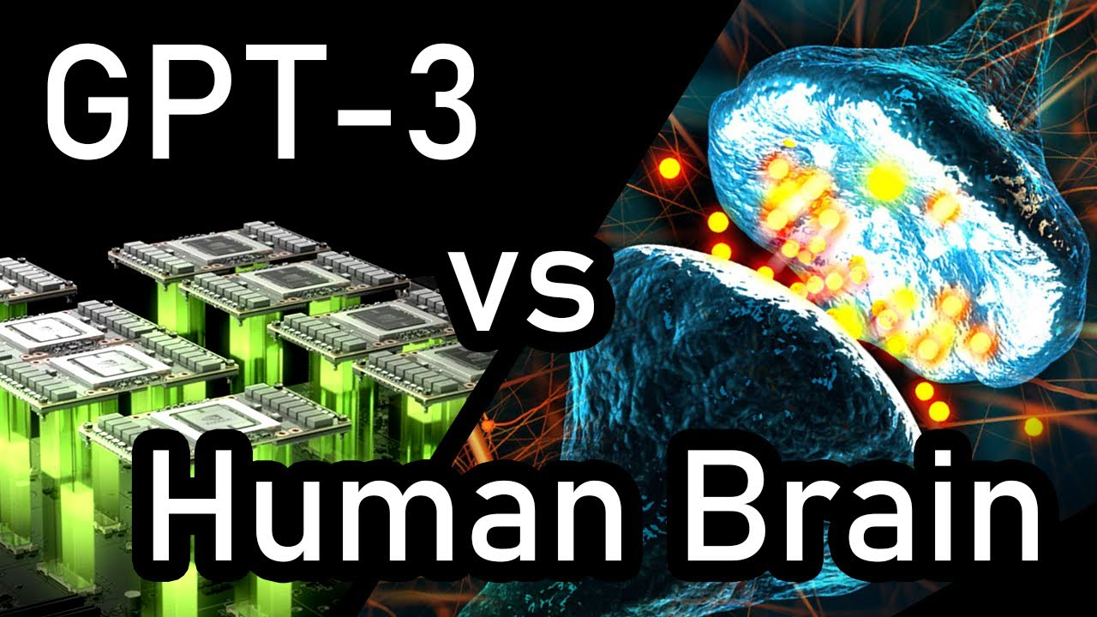
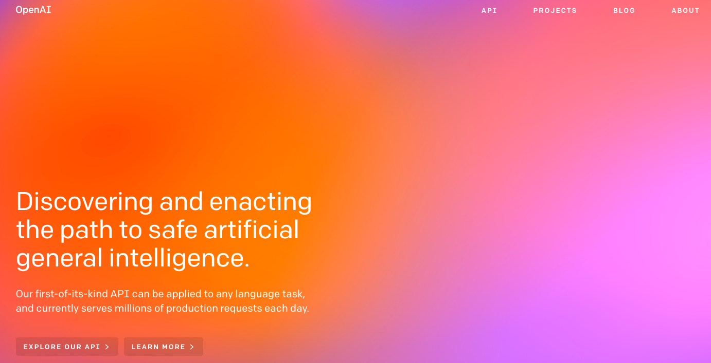
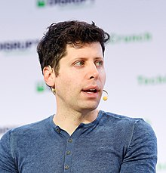
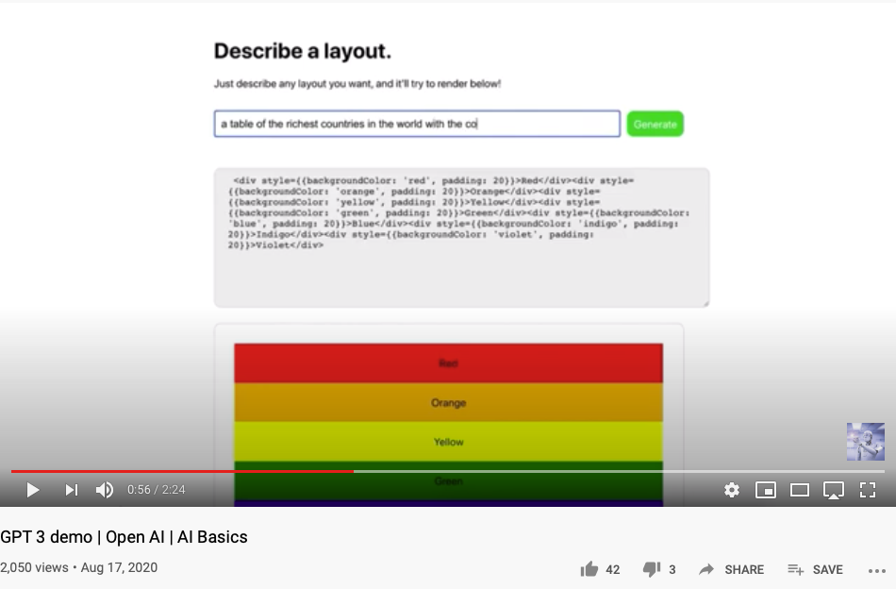
Namespace Management with Open AI
An “open” Artificial Intelligence resource that is available for “free”.
It will do your software development work for you for free, too.

Slide 23


Methods and Tools
MediaWiki as a Tool
Data in MediaWiki/Wikipedia
Templates and Categories
Structures and Strategies in Namespace Management

Slide 24
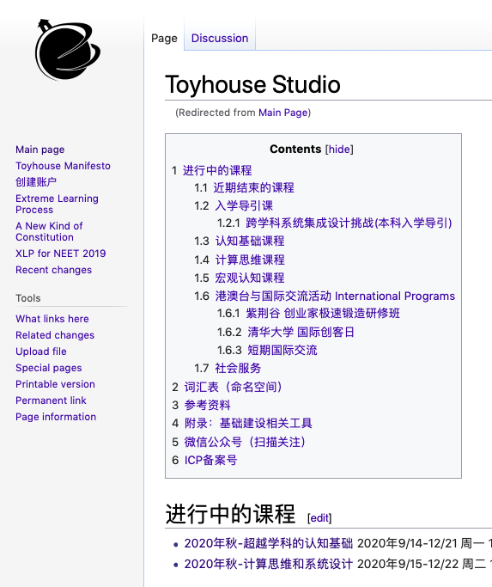
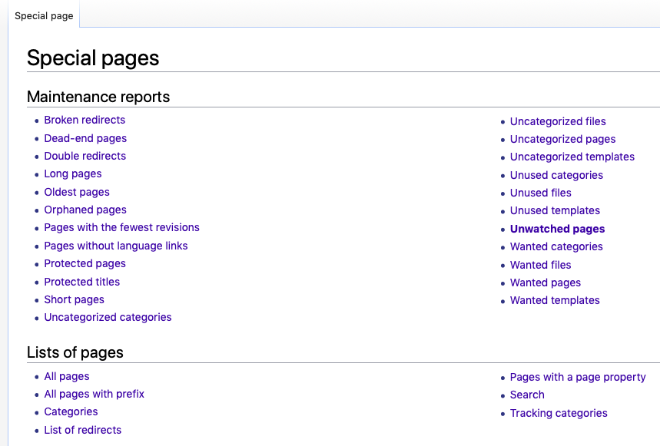
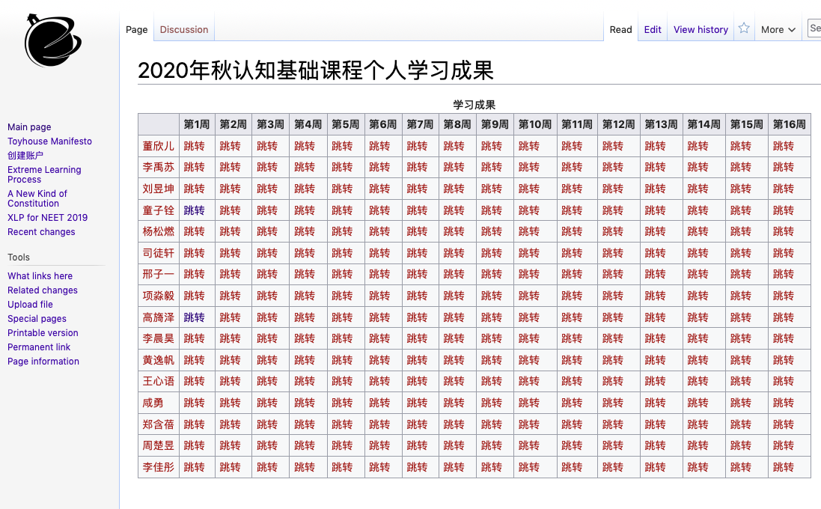
Naming your Learning Actions

Slide 25
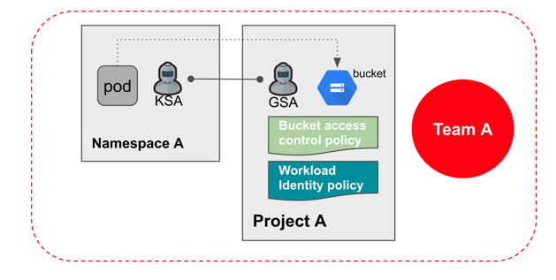

Operational Concerns
Access Rights
Editorial Decisions
Process Management
Image source: https://www.keeprunning.io/2019/09/24/workload-identity-config-connector/
Production Workflow of
Namespace Management

Slide 26

Access Rights and Secure Workflow
What is DevSecOps?
Image courtesy: Paladion Corporation Website Image source: https://www.paladion.net

Slide 27
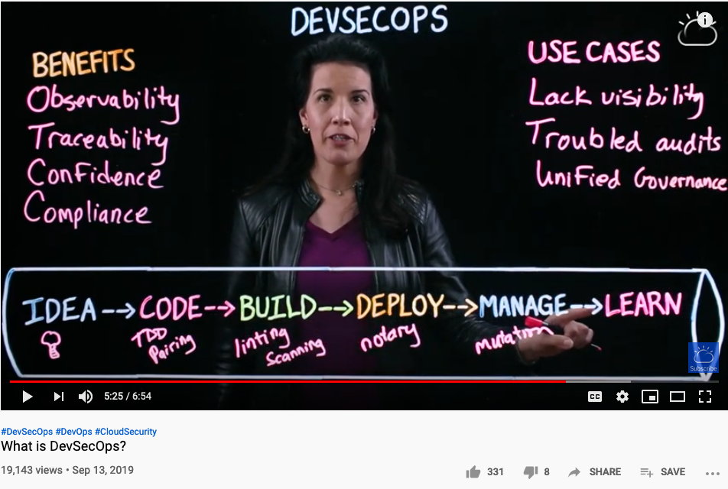
What is DevSecOps?

Slide 28







A Model of Collective Cognitive Processes
(students/teachers)
(Smart) Social Contract Execution
Traders
Miners
Coders
(Consumers/Distributors)
Three Asynchronous
Clocks in their respective
Communities
Version Upgrade
Production Code
Function Requests
Customer Crisis
Feature Revolution
Emerging cases or
systematic attacks
(Artists/Creative Projects)
(Administrators/Witnesses)
Perform Checking
receive confirmation
commit transaction
(Content Producers/Product Designers)
(Accountants/Lawyers)

Slide 29


Kuhn Cycle: the evolution of a Namespace
Normal Science
Model
Drift
Model Crisis
Model Revolution
Paradigm
Change
Emerging cases or
systematic attacks
Product Development Process
in five stages
Commit
Build
Test
Stage
Deploy
Unknown/incompatible names introduces crisis. (incommensurability).

Slide 30
Decisions are made by different kinds of People
Traders
（students/teachers）
Miners
（Administrators/Witnesses）
Coders
(Artists/Creative People)
(Consumers/Distributors)
(Content Producers/Product Designers)
(Accountants/Lawyers)

Slide 31


Observability of Multi-Scale DevSecOps Processes
Traders
（students/teachers）
Miners
（Administrators/Witnesses）
Coders
(Artists/Creative People)
Sec
(Consumers/Distributors)
Dev
Ops
(Content Producers/Product Designers)
(Accountants/Lawyers)

Slide 32
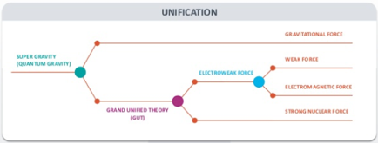
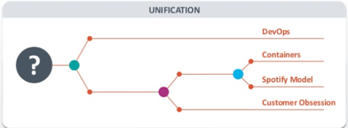
A Unified Namespace
What are representables?
A Portal to all Names
Human-Machine Interface
Physical and Information Sciences shares the same Challenge

Slide 33

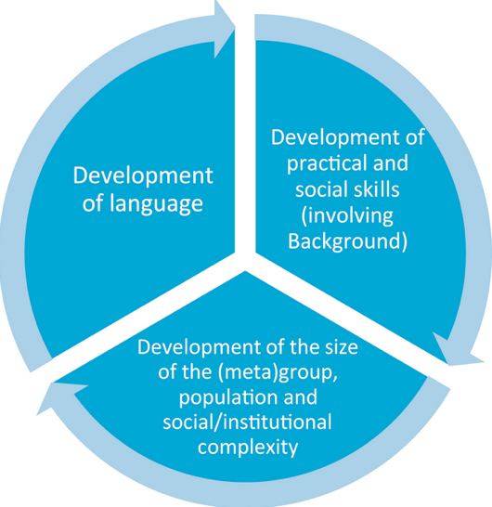
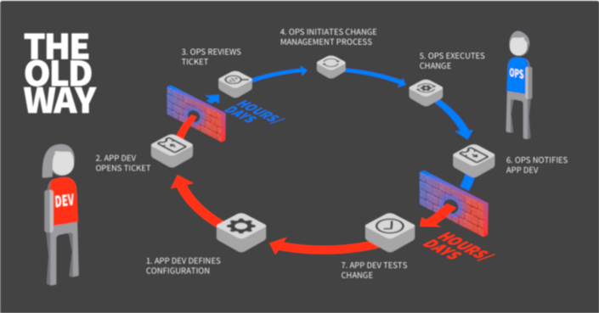



A linguistic approach to unify the cognizance across scales
Namespace = Cognitive Space

Slide 34

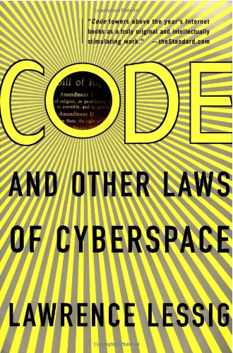

Code is Law

Slide 35
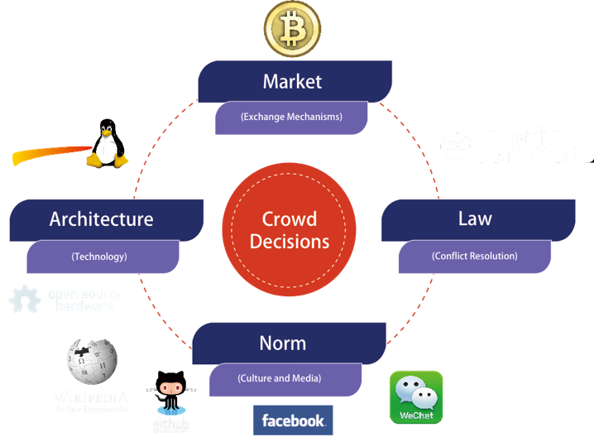
A Unified Context for the Collective Cognizance
Far
Space
near
before Time after

Slide 36
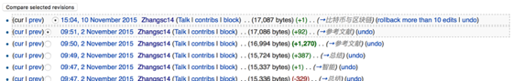

Three Scales of Time
Mesoscopic：
Localized Adjustments
Time Stamp
Macroscopic:
Five Stages of Evolution
Normal Science
(commit)
Model
Drift
(build)
Model Crisis
(test)
Model Revolution
(stage)
Paradigm Change
(deploy)
Microscopic：
Process Data and Summative Result
Time Stamp

Slide 37
Time Stamped Data Preserve Event Ordering Information
Normal Science
(commit)
Model
Drift
(build)
Model Crisis
(test)
Model Revolution
(stage)
Paradigm Change
(deploy)
Time Stamp
Time Stamp
Time Stamp
Time Stamp

Slide 38
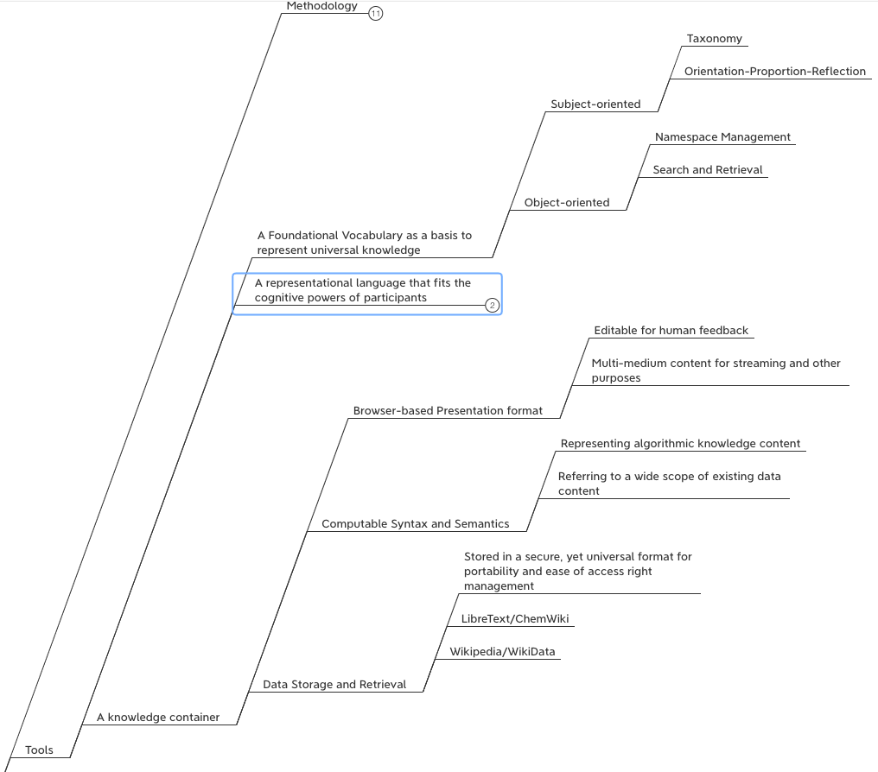






Abundant Tools and Data Sources for Large-Scale Knowledge Representation

Slide 39

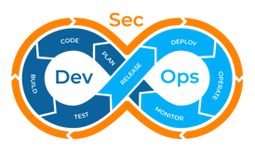



We are in the Universe, now!
Library of
Linked Knowledge
(Data Plane)
Library of Executable Algorithms
(Control Plane)

Slide 40

Discussion and Future Applications
Past Known efforts
Alternative Strategies?
Other Applications?
Round Table Discussion

Slide 41
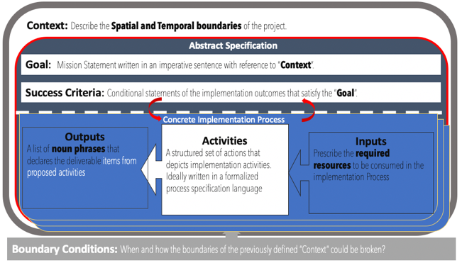
Logic Model (OKRs) as a Transdisciplinary Foundation

Slide 42



Reference Materials on OKRs

Slide 43
Context: Describe the Spatial and Temporal boundaries of the project.
Contextualized Objectives
Goal: Mission Statement written in an imperative sentence with reference to “Context”.
Success Criteria: Conditional statements of the implementation outcomes that satisfy the “Goal”.
Concrete Implementation Process
Process that Delivers Key Results
Outputs
A list of noun phrases that declares the deliverable items from proposed activities
Activities
A structured set of actions that depicts implementation activities.
Ideally written in a formalized process specification language
Outputs
A list of noun phrases that declares the deliverable items from proposed activities
Activities
A structured set of actions that depicts implementation activities.
Ideally written in a formalized process specification language
Inputs
Prescribe the required resources to be consumed in the implementation Process
Inputs
Prescribe the required resources to be consumed in the implementation Process
Boundary Conditions: When and how the boundaries of the previously defined ”Context” could be broken?

Slide 44


Context: Modern Technologies challenges the cognitive capacities of human and human societies.
Goal: Provide a methodical cognitive framework to leverage contemporary technologies and cognitive science content.
Success Criteria: Enable students to utilize cognitive methods and tools, while measuring learning outcomes accordingly.
Outputs
Cognitive Science Report
Summarize your methods
Digitally published Learning Reports
Behavioral Data (on MediaWiki)
Personally chosen application areas
Biology, Physics, Math, Literature, Social Science, Arts, …
Activated Processes
1. Course Preparation
Content and Process design
2. Learning Program Execution
16 week exercise
3. Program Refinement
Continuous Adjustments
Periodic Refinements
Inputs
Curricular Structure
Coherent with university-level curriculum design
Content Data
A time-oriented knowledge(data) representation framework
Meta Data Formats
Logic Model(OKRS), Learning Report Format, Universal Resource Locators
Boundary Conditions: Personal willingness to adopt a new cognitive foundation, and intensity of practicing this new skill

Slide 45
Students Actions before Wednesday Sep 16
Register on toyhouse.wiki:81 with an account
Create a personal page with bio
Create a link in the personal page to your weekly learning report
Learn to use Mediawiki’s Template, and Category features (use the Logic Model template)
Start writing your learning report.
Every week should include Logic Model
500 words or more per week

